Slide 1
Terminal Application
TaniaMagro_T1A3
Task List
Feature Breakdown

Slide 2
Purpose
TaniaMagro_T1A3
The purpose of the terminal application was to create a useable Task List. Within this application, you can:
Create lists (multiple lists)
Add tasks to a specific list
Edit tasks
Delete tasks
Delete lists

Slide 3
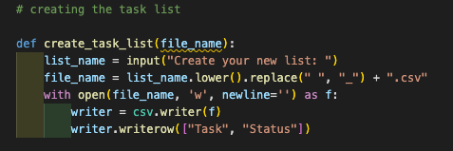
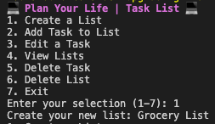

Create Task List
TaniaMagro_T1A3
Within this function, you can create your List/s. The lists can be created for anything (e.g. Grocery List, Movie List, Reading List)
String:
‘.lower() – Converts the name of the list being created (standardising the file name)
’.replace(” “, “_”) – To ensure the CSV file is valid, all spaces are replaced with an underscore
Variables:
File_name – various uses of the file-name
Create the file in csv (your task list) (as this has not been created as yet)
File handling
‘w’ – Write Only: Creates the name of the list, only.

Slide 4
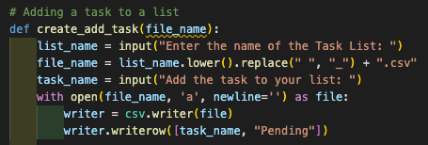
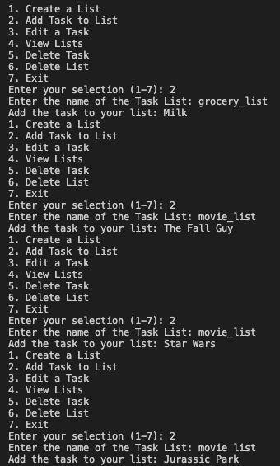
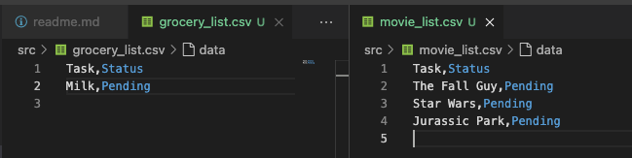
Adding a Task to Your List
TaniaMagro_T1A3
Within this function, you can create your List/s. The lists can be created for anything (e.g. Grocery List, Movie List, Reading List)
String:
‘.lower() – Converts the name of the list being created (standardising the file name)
’.replace(” “, “_”) – To ensure the CSV file is valid, all spaces are replaced with an underscore
Variables:
File_name – various uses of the file-name
Connects to the csv file that was previously created to add the task to the list
File handling
‘a’ – Append: Allows the user to amend the open file (add the task to your list)
‘newline=‘’ – the task is added to a new line
Writer.wroterrow([task_name, “Pending”]) – writes that task to a row within a csv file and sets the staus as pending

Slide 5
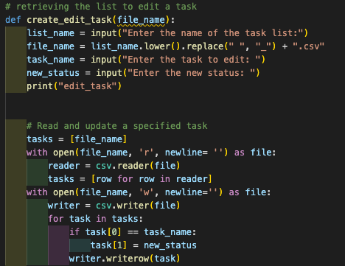
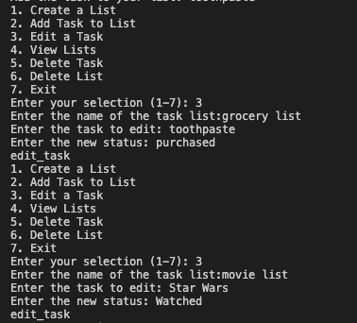
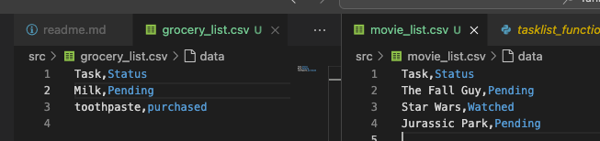
Retrieving a List to edit a Task
TaniaMagro_T1A3
Within this function, you can create your List/s. The lists can be created for anything (e.g. Grocery List, Movie List, Reading List)
Loops:
‘for task in task’ – used to iterate over the tasks listed within the csv file
Conditional Control:
If statement:
Checks if the requested task, matches the user input. If there is a match the status of the task is updated
Variables:
File_name – various uses of the file-name
Connects to the csv file that was previously created to add the task to the list
File handling
‘r’ – Read mode: Opens the lists to view or read only
‘w’ – Write Only: Allows the user to amend the status of the task (pending to purchased or watched – in the examples below.)
‘newline=‘’ – the task is added to a new line
Writer.wroterrow([task_name, “Pending”]) – writes that task to a row within a csv file and sets the staus as pending

Slide 6
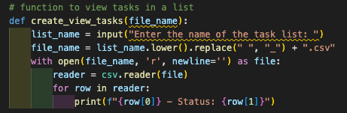
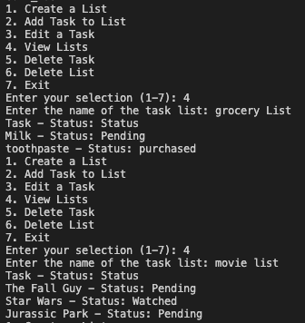
View Tasks in a List
TaniaMagro_T1A3
Within this function, you can create your List/s. The lists can be created for anything (e.g. Grocery List, Movie List, Reading List)
Variables:
File_name – various uses of the file-name
Connects to the csv file that was previously created to add the task to the list
List_name – The list name the user inputs into the terminal selection
File handling
‘r’ – Read mode: Opens the lists to view or read only

Slide 7
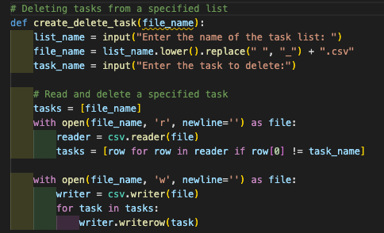
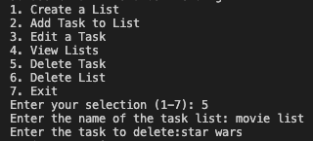
Deleting Tasks for a Specific List
TaniaMagro_T1A3
Within this function, you can create your List/s. The lists can be created for anything (e.g. Grocery List, Movie List, Reading List)
Loops:
‘for task in task’ – used to iterate over the tasks listed within the csv file
Variables:
File_name – various uses of the file-name
Connects to the csv file that was previously created to add the task to the list
List_name – The list name the user inputs into the terminal selection
File handling
‘r’ – Read mode: Opens the lists to view or read only

